Slide 1
Don’t let Cancer become the Forgotten “C” in the fight against COVID-19
Prof Mark Lawler
Associate Pro-Vice-Chancellor and Professor of Digital Health,
Queen’s University Belfast; Scientific Director DATA-CAN, the UK’s
Health Data Research Hub for Cancer

Slide 2


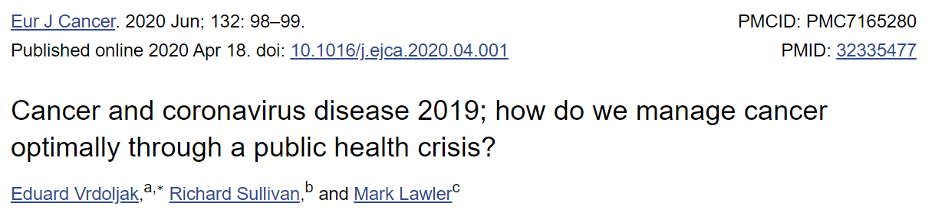
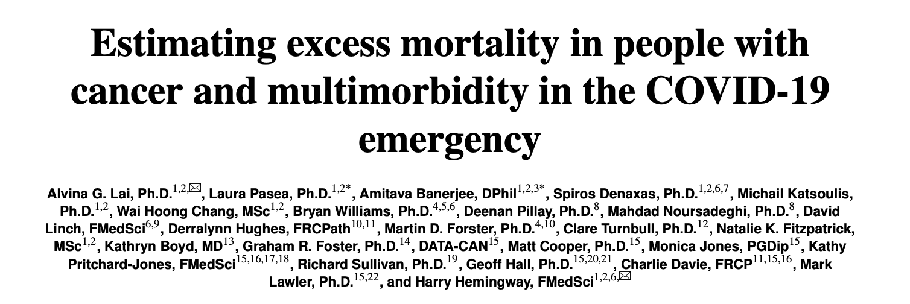
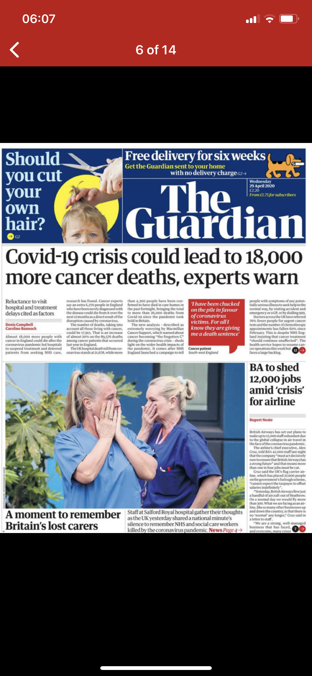
COVID-19 and Cancer – What was the Spark?
Data-Driven Collaboration between DATA-CAN and University College London
Accessing Real Time Data from Hospital Trusts (England and Northern Ireland)
Modelling excess deaths due to the adverse effects of the COVID-19 pandemic
“patients are starting to fear a COVID-19 diagnosis
more than a cancer diagnosis”
Notes:
The NHS and other organisations already collect lots of health data. But it is not always quick and easy for researchers to access and analyse data, and link this data together, to develop new treatments and improve cancer services. DATA-CAN will make it faster and easier for researchers to combine and use data from across the UK securely. This will enable research that develops better cancer care, gives patients faster access to clinical trials and creates new investment in UK healthcare.

Slide 3
Covid-19 and Cancer
Real Time Data analysis
DATA-CAN researchers accessed / analysed data from Hospital Trusts across the UK
Decided to initially look at two measures which are routinely captured
2 Week Waiting Time for Cancer Referrals (early warning system for suspicion of cancer)
Chemotherapy attendances (proxy measure of the “health” of the cancer service)
Notes:
The NHS and other organisations already collect lots of health data. But it is not always quick and easy for researchers to access and analyse data, and link this data together, to develop new treatments and improve cancer services. DATA-CAN will make it faster and easier for researchers to combine and use data from across the UK securely. This will enable research that develops better cancer care, gives patients faster access to clinical trials and creates new investment in UK healthcare.

Slide 5
Covid-19 and Cancer
Real Time Data analysis
DATA-CAN researchers accessed / analysed data from Hospital Trusts across the UK
Decided to initially look at two measures which are routinely captured
2 Week Waiting Time for Cancer Referrals (early warning system for suspicion of cancer)
-68.7% to -84.3%; median = -70.4%
Chemotherapy attendances (proxy measure of the “health” of the cancer service)
-26.3% to -63.4%; median = -41.5%
Notes:
The NHS and other organisations already collect lots of health data. But it is not always quick and easy for researchers to access and analyse data, and link this data together, to develop new treatments and improve cancer services. DATA-CAN will make it faster and easier for researchers to combine and use data from across the UK securely. This will enable research that develops better cancer care, gives patients faster access to clinical trials and creates new investment in UK healthcare.

Slide 6
COVID-19 and Cancer
Real Time Data analysis
DATA-CAN researchers accessed / analysed data from large Hospital Trusts across England and all 5 Trusts in NI
Looked at two measures to determine the effect of the pandemic on cancer services
2 Week Waiting Time for Cancer Referrals (early warning system for suspicion of cancer)
7 out of 10 people with suspicion of cancer were not getting referred to cancer specialist services
Chemotherapy attendances (proxy measure of the “health” of the cancer service)
4 out of 10 cancer patients were not getting access to their chemotherapy
First data that drew attention of the government, academia, NHS and the public to the disastrous effect of COVID-19 on Cancer
With thanks to Cara Anderson, Kathryn Boyd and Joy Peacock
Notes:
The NHS and other organisations already collect lots of health data. But it is not always quick and easy for researchers to access and analyse data, and link this data together, to develop new treatments and improve cancer services. DATA-CAN will make it faster and easier for researchers to combine and use data from across the UK securely. This will enable research that develops better cancer care, gives patients faster access to clinical trials and creates new investment in UK healthcare.

Slide 7
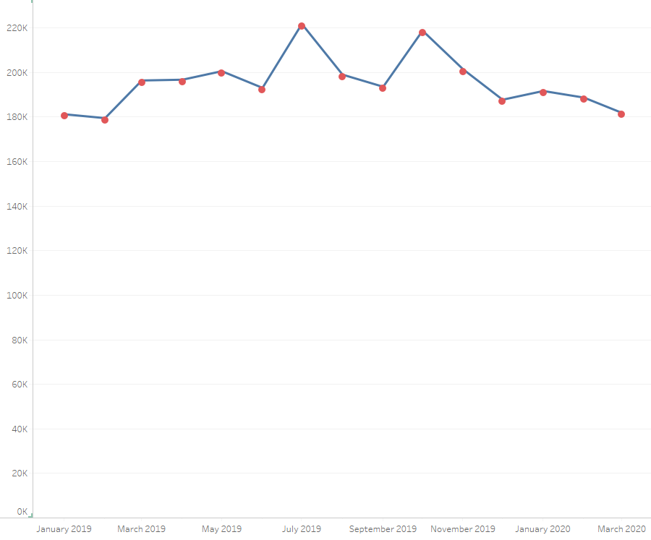
Why we need Real Time Data
Looking at National Data on the 9th June
2020
– only have data up as far as March
2020 (almost 3 months delay)
– no signal of any effect of the COVID-19
pandemic
English 2WW data as of Jun 9th 2020

Slide 8
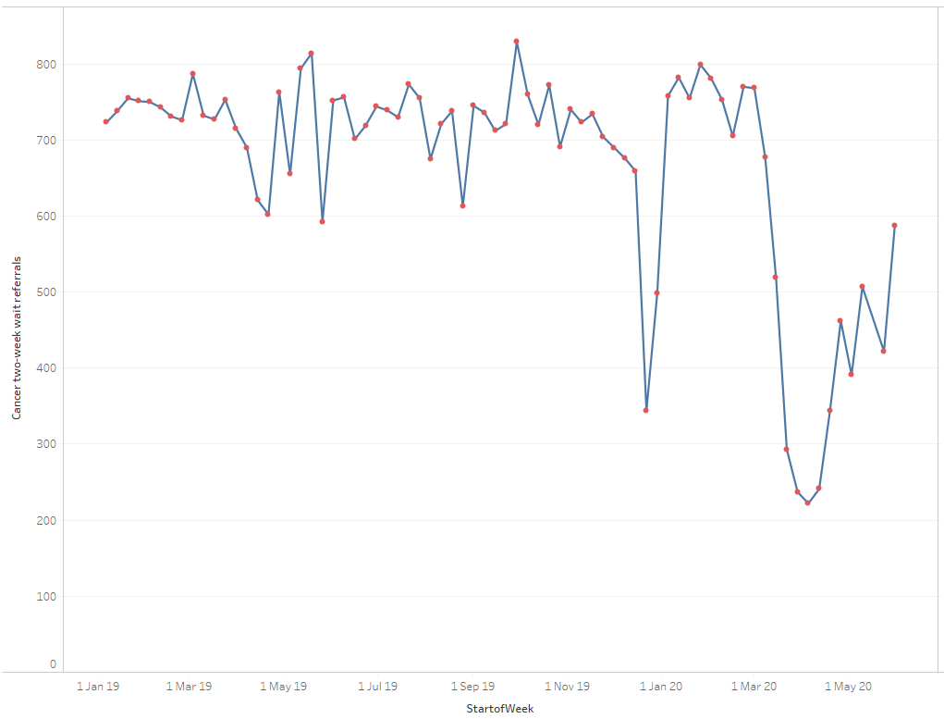
Why we need Real-time data
  Real Time data allows us to see up to date data (5th June just 4 days earlier)
  Captures not only the precipitous drop in urgent
  cancer referrals, but also the start of recovery of
  the urgent diagnostic pathway
5th June
Real Time 2WW data 2019 to Jun 9th 2020
3,200 missing referrals - Leeds

Slide 9
Disruptions to cancer services across the pathway due to the COVID-19 pandemic
Disruption was felt across the entire cancer pathway
Presentational Delay, Diagnostic Delay and significant impact on treatment
Significant disruption of cancer research (clinical trials, discovery research, translational research)
https://www.carnallfarrar.com/life-sciences/life-sciences-insights/disruption-and-recovery-of-cancer-from-covid-19/)

Slide 10
Covid-19 and Cancer: Excess
Mortality
Looked at excess mortality employing the 3.8M CALIBER primary/secondary care linked data set
Modelled different scenarios to determine excess deaths due to pandemic
Used Real Time Data from Hospital Trusts to Inform the Model
Notes:
The NHS and other organisations already collect lots of health data. But it is not always quick and easy for researchers to access and analyse data, and link this data together, to develop new treatments and improve cancer services. DATA-CAN will make it faster and easier for researchers to combine and use data from across the UK securely. This will enable research that develops better cancer care, gives patients faster access to clinical trials and creates new investment in UK healthcare.

Slide 11
Covid-19 and Cancer: Excess
Mortality
Looked at excess mortality employing the 3.8M CALIBER primary/secondary care linked data set
Modelled different scenarios to determine excess deaths due to pandemic
Used Real Time Data from Hospital Trusts to Inform the Model
Significant predicted excess deaths in one year (England)
7,165 – 17,910 excess deaths
Notes:
The NHS and other organisations already collect lots of health data. But it is not always quick and easy for researchers to access and analyse data, and link this data together, to develop new treatments and improve cancer services. DATA-CAN will make it faster and easier for researchers to combine and use data from across the UK securely. This will enable research that develops better cancer care, gives patients faster access to clinical trials and creates new investment in UK healthcare.

Slide 12
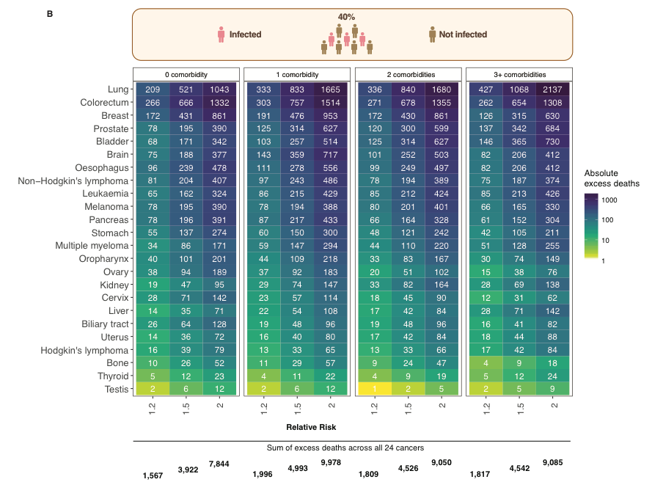
Covid-19 and Cancer: Excess
Mortality and Comorbidities
Looked at excess mortality employing the 3.8M CALIBER primary/secondary care linked data set
Modelled different scenarios to determine excess deaths due to pandemic
Significant predicted excess deaths in one year (England)
Additional risk of excess deaths with at least one additional underlying health condition (comorbidities)
Cardiovascular disease, Hypertension, Obesity, Diabetes, COPD
Notes:
The NHS and other organisations already collect lots of health data. But it is not always quick and easy for researchers to access and analyse data, and link this data together, to develop new treatments and improve cancer services. DATA-CAN will make it faster and easier for researchers to combine and use data from across the UK securely. This will enable research that develops better cancer care, gives patients faster access to clinical trials and creates new investment in UK healthcare.

Slide 13
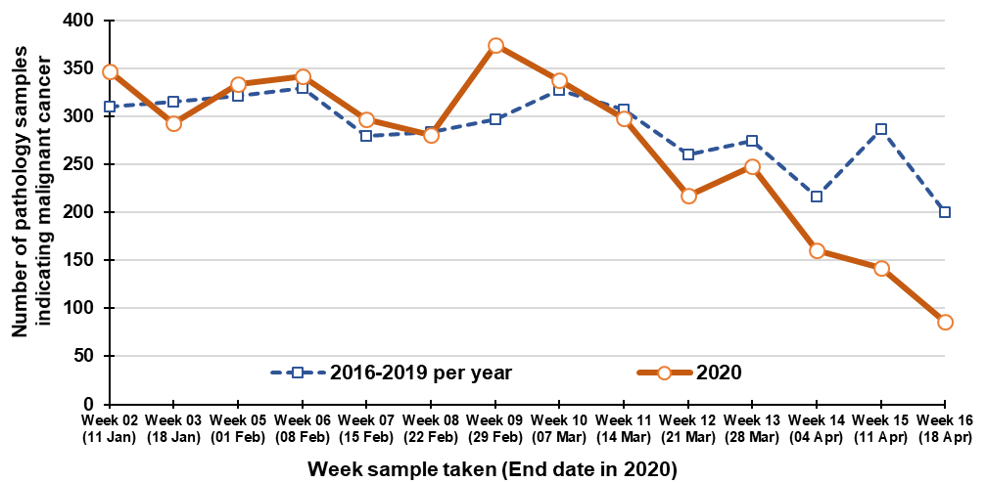

Trends in the number of pathology samples indicating malignant cancer (ex. NMSC)
Compared to 2016-2019 average
-31%
Five-week total to 18th April:
With Thanks to Anna Gavin and David Donnelly

Slide 14
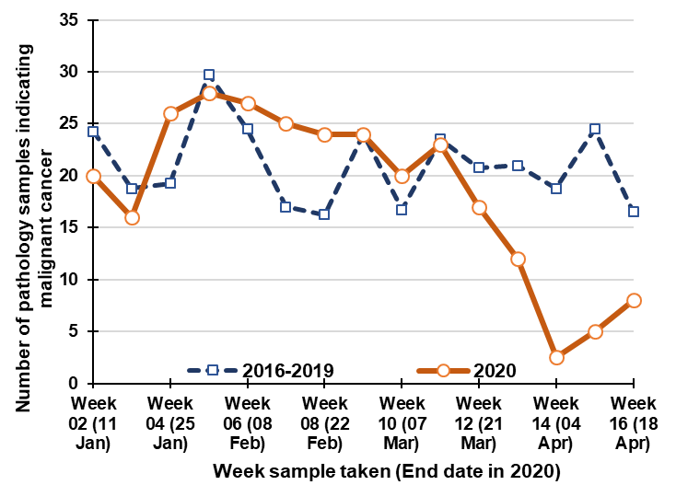
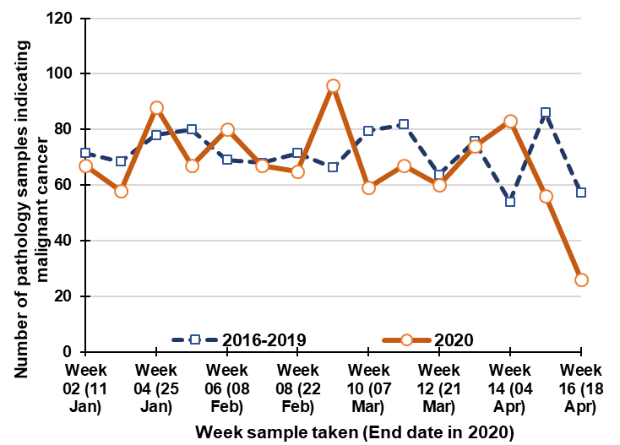
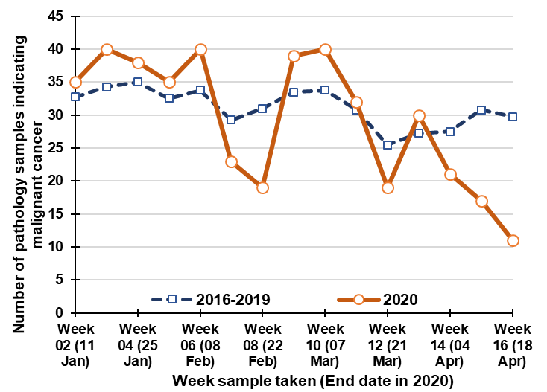
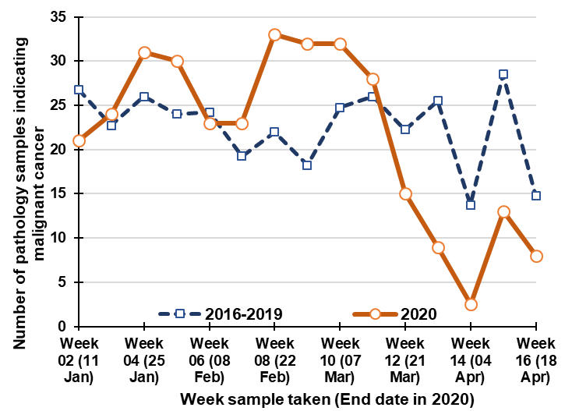
Lung cancer
Female breast cancer
Compared to 2016-2019 average
-56%
Five-week total to 18th April 2020
-11%
Five-week total to
18th April 2020
Bowel cancer
Prostate cancer
Compared to 2016-2019 average
-30%
Five-week total to 18th April 2020
Compared to 2016-2019 average
-55%
Five-week total to 18th April 2020
With Thanks to Anna Gavin and David Donnelly

Slide 15

Covid-19 – Significant Impact on Recruitment to Cancer Clinical Research/Cancer Clinical Trials
From 19 March 2020, recruitment to all cancer clinical trials in NI was suspended with the exception of paediatric studies and 3 haematology studies deemed critical to clinical need
NICTN | No of active studies in portfolio 20/03/2020 | Suspended/on hold prior to COVID for other reasons | Remained opened | Suspended by Sponsor | Suspended by NICTN | Not planned to re-open | Now re-opened | New studies since 20/03/2020
TOTAL | 75 | 4 | 14 | 27 | 34 | 4 | 7 | 1
From mid May 2020 on-going portfolio review for studies that can safely be re-opened
Rapid approval and opening of PACE: ‘Patients with AML and COVID-19 Epidemiology’
>80% of trials
suspended
With thanks to Melanie Morris and Ruth Boyd

Slide 16
Additional Evidence
Sud A, Torr B, Loveday C, Jones M, Broggio J, Scott S, Gronthoud F, , Nicol DL, Garrett A, Jhanji S, Boyce SA, Williams M, Lyratzopoulos G, Barry C, Riboli E, Kipps E, Muller DC, Larkin Navani N, Swanton C, McFerran E, Lawler M, Houlston R, Turnbull C.
COVID-19 Lockdown and its impact on the two-week wait pathway for suspected cancer (Lancet Oncology 2020)
Loveday C, Sud A, Jones M, Broggio J, Scott S, Torr B,; Garrett, A, Nicol DL, Jhanji S, Boyce SA, Williams M, Lyratzopoulos G, Barry C, Riboli E, Kipps E, McFerran E, Muller DC, Abulafi M, Lawler M, Houlston R, Turnbull C.
Prioritisation by Faecal Immunochemistry Testing (FIT) to mitigate the impact of delays in the 2-week wait colorectal cancer referral pathway during the COVID-19 pandemic: a UK modelling study (Gut 2020)
Lawler M, Rodin D, Sullivan R.
COVID-19 and cancer on both sides of the pond: Different continents, similar challenges JAMA Oncol, in preparation
Others in development

Slide 17
One Step Forwards Two Steps Backwards
Five-year survival anticipated for 2020 (England)
Assuming 3 months of disruption (which may be conservative), stage shift in detection of cancer (i.e. detecting cancer later rather than earlier) due to disruptions to the cancer pathway could significantly affect five-year survival
For certain cancers e.g. colorectal,
the COVID-19 pandemic could set us
back nearly a decade
https://www.carnallfarrar.com/life-sciences/life-sciences-insights/disruption-and-recovery-of-cancer-from-covid-19/)

Slide 18

International Viewpoint
Researchers in many other countries following our approach in analysing (near) real time data - they are at different stages - published data still relatively scarce
Presented our data to the European Cancer Organisation (Europe's largest multidisciplinary cancer organisation) - a lot of interest and anecdotally similar situation being experienced across Europe, but drops may be less profound
Prof Lawler is co-leading a European Cancer Organisation Special Network on Covid-19 and Cancer (https://www.europeancancer.org/topic-networks/16:impact-of-covid-19-on-cancer)
Linking in with other international studies
Provided evidence into WHO Europe (70th Session WHO Regional Committee for Europe)
https://www.euro.who.int/en/about-us/governance/regional-committee-for-europe/70th-session/multimedia/video-gallerystatements-from-non-state-actors

Slide 19
Covid-19 and Cancer
Impact
Results shared pre-submission with governmental/NHS stakeholders including all four CMOs, National Cancer Director and SAGE, contributed to decision to start restoring cancer services
Association of British Pharmaceutic Industries: DATA-CAN should be supported to help “restore standards of care in cancer.”
Research Community – Over 18,000 hits on ResearchGate
Media/Public: Main story Guardian, Telegraph; significant coverage Daily Mail, Financial Times, Sun, Sunday Independent, Wall Street Journal, others including print/online in France, Germany and Spain
Lead story on Sky News; Interviews with BBC, ITV, Channel 4, NBC News, SBS News, multiple local radio
Media Question to Prime Minister on his first press briefing post return from COVID-19 hospitalisation
6th July Panorama https://www.bbc.co.uk/programmes/m000kqzv
31st July “Phase III Letter” from Simon Stevens (CEO NHS) lays out mandatory steps to address cancer, listing it as the “first priority for recovery”
Notes:
The NHS and other organisations already collect lots of health data. But it is not always quick and easy for researchers to access and analyse data, and link this data together, to develop new treatments and improve cancer services. DATA-CAN will make it faster and easier for researchers to combine and use data from across the UK securely. This will enable research that develops better cancer care, gives patients faster access to clinical trials and creates new investment in UK healthcare.

Slide 20
Implications and Actions
Quoted extensively in recent report from Carnall Farrar and the Institute for Public Policy Research (https://www.carnallfarrar.com/life-sciences/life-sciences-insights/disruption-and-recovery-of-cancer-from-covid-19/)
8th September Question to Health Secretary Matt Hancock from the Health and Social Care Select Committee based on our data
Our research on excess deaths and significant perturbations of cancer care have profound implications for health services globally and must be addressed urgently
Highlights why unlocking the power of data is so important and emphasises the absolute requirement to access weekly data in (near) real time - so rather than “Follow the Science”, “Follow the Data”
Data-empowered real-time sharing by Hospital Trusts represents a “culture change” on data deployment for better healthcare.
Getting back to Pre COVID-19 levels isn’t enough - The New Normal can’t be the same as the Old Normal

Slide 21
Supporting the recovery
Presentational/diagnostic/treatment delays in colorectal cancer due to the COVID-19 pandemic have potential to cause significant excess deaths and loss of life years
Our work¹ shows that prioritisation using Faecal Immunochemical Testing (FIT – a test to help in highlighting suspicion of cancer) can help avoid nearly 90% of these deaths attributable to presentational/diagnostic delay, whilst reducing immediate requirement for colonoscopy (the key test for diagnosing cancer) by >80%.
Can help support both the health system (by prioritising use of tests (e.g. colon-oscopy) for those who most require them, solving capacity problems, but more importantly patients – to ensure that presentational/diagnostic delays are reduced
Only a short term solution – need to ensure we have sufficient colonoscopy long term
¹Loveday C, Sud A, Jones M, Broggio J, Scott S, Torr B,; Garrett, A, Nicol DL, Jhanji S, Boyce SA, Williams M, Lyratzopoulos G, Barry C, Riboli E, Kipps E, McFerran E, Muller DC, Abulafi M, Lawler M, Houlston R, Turnbull C. Prioritisation by Faecal Immunochemistry Testing (FIT) to mitigate the impact of delays in the 2-week wait colorectal cancer referral pathway during the COVID-19 pandemic: a UK modelling study Gut 2020

Slide 22
Unlocking the Power of Data to improve cancer care

